Slide 1

Sanctum Character App Progress Update
Johnathan Partridge

Slide 2
Project Description Overview
An application to host character sheets online, with live updating between connected clients.

Slide 3
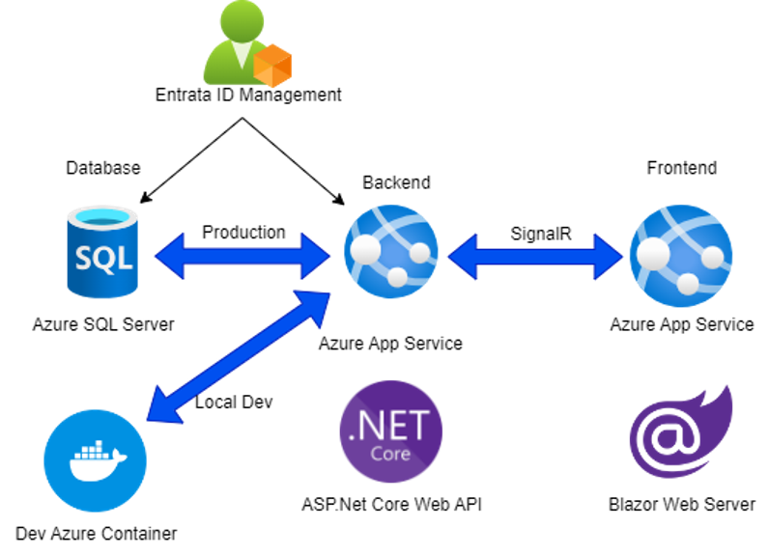
Tech Stack

Slide 4
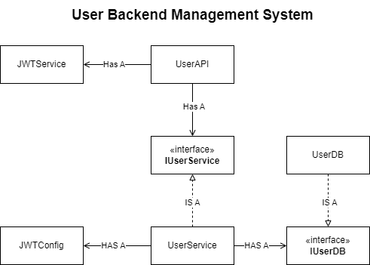
Backend User System

Slide 5
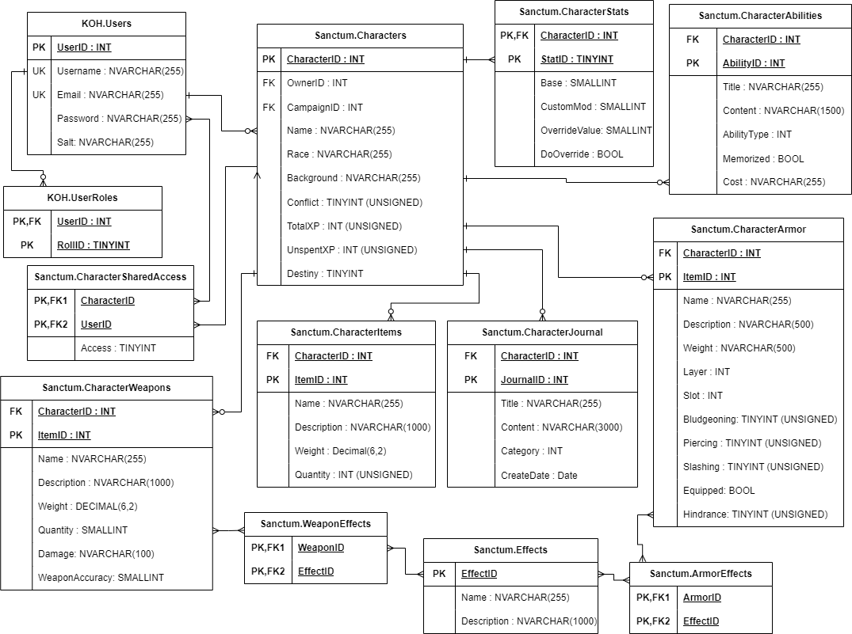
Database ERD

Slide 6
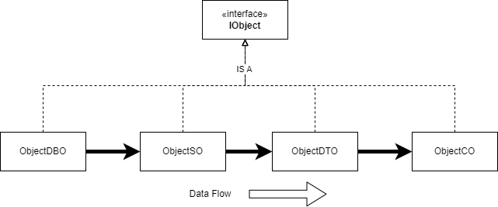
Data Layout
Every stored procedure has a DBO object related to its results.

Slide 7
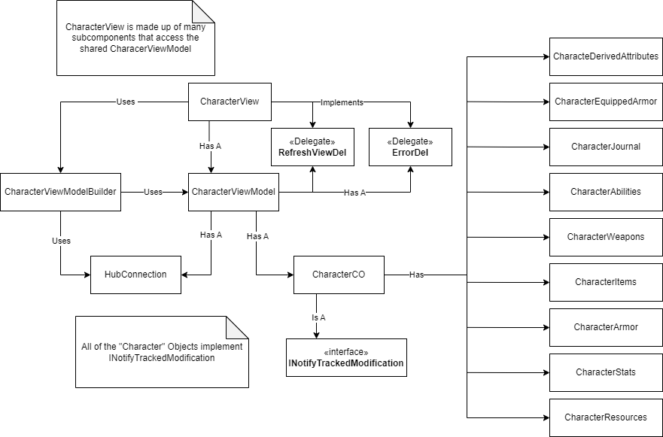
Front End Character System

Slide 8
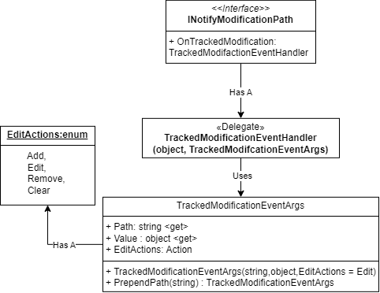
INotify Tracked Modification

Slide 9
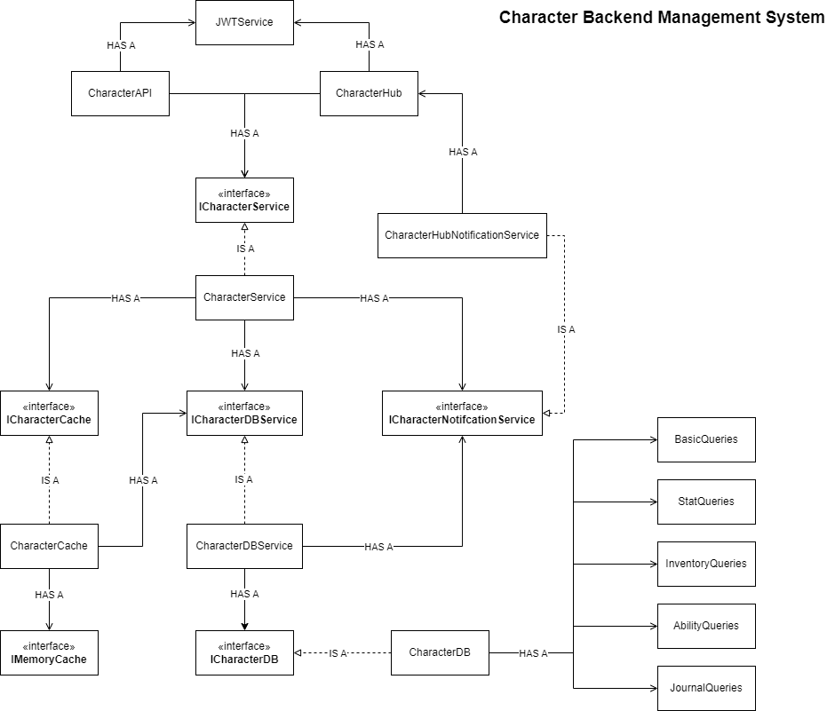
Backend Character System

Slide 10
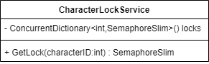
Async Locking System
How to use
Use GetLock() to Get the Semaphore associated with the CharacterID.
Use the Semaphore.WaitAsync() to wait for access to the CharacterID.
When finished use Semaphore.Release()
This process allows the async locking of actions on a Character by locking access to the CharacterID.

Slide 11
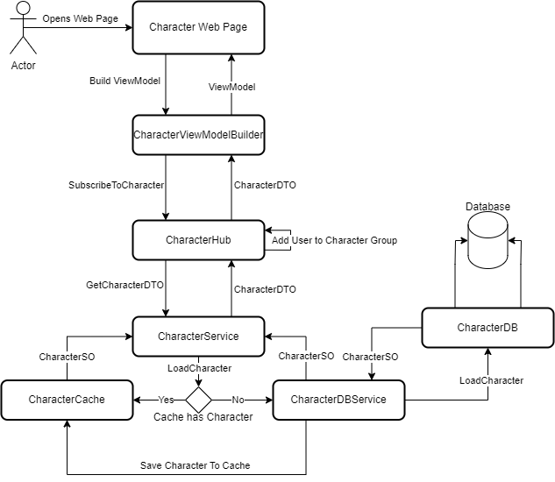
Load Character Page

Slide 12
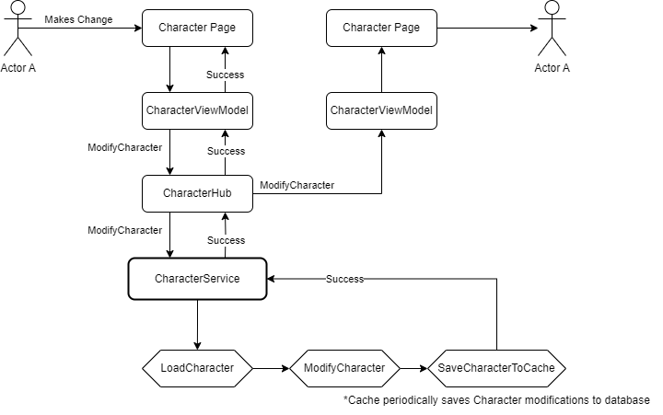
Modify Character

Slide 13
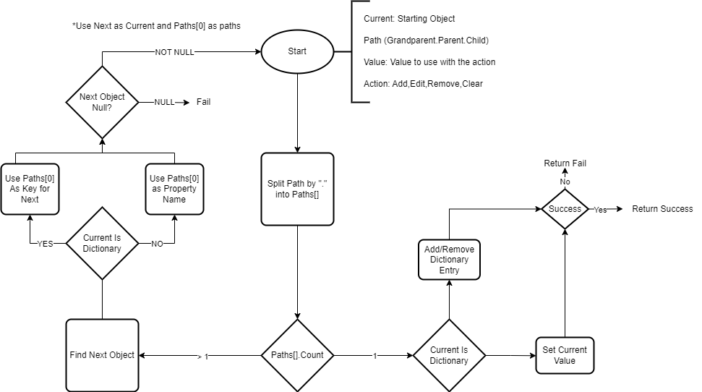
Recursive ModifyByPath Algorithm

Slide 14
Armor Layering Problem
We can store armor slots in the binary representation of an integer.
0000 0000 0000 0000
Each bit represents whether a piece of armor takes up the corresponding spot.
For example:
0000 0000 0000 0011
Would represent an Armor Piece that covers the head and neck.
Problem: A piece of armor can cover X parts of the body, and takes up a Armor Layer (Light,Medium,Heavy)
For each slot you can only have one of each type of layer.
There are a total of 12 slots

Slide 15
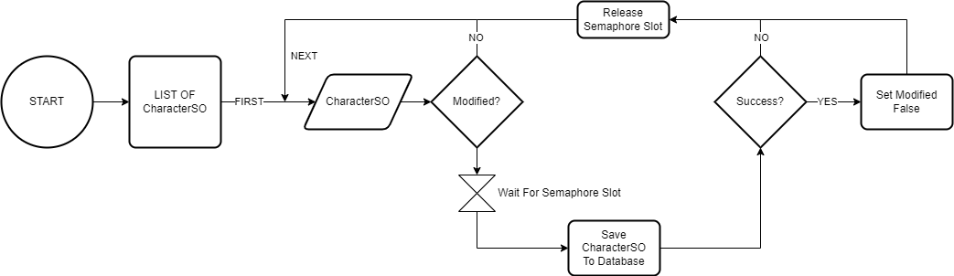
Caching Algorithm Background Service

Slide 16

UI Demo

Slide 17
Road Map
User Account (MVP)
Creation
Deletion
Management
Character Sheet (MVP)
Creation
Deletion
Live Updating
Frontend Site (MVP)
User Interface WIP
Backend Server (MVP)
Auth/Data Management
SQL Server (MVP)
Cloud Hosting (v1.0)
Campaign Creation (v1.0)
Implementing sharing sheets first

Slide 18

Questions?

